Slide 1
Network-CZM
Jianming Zeng

Slide 2
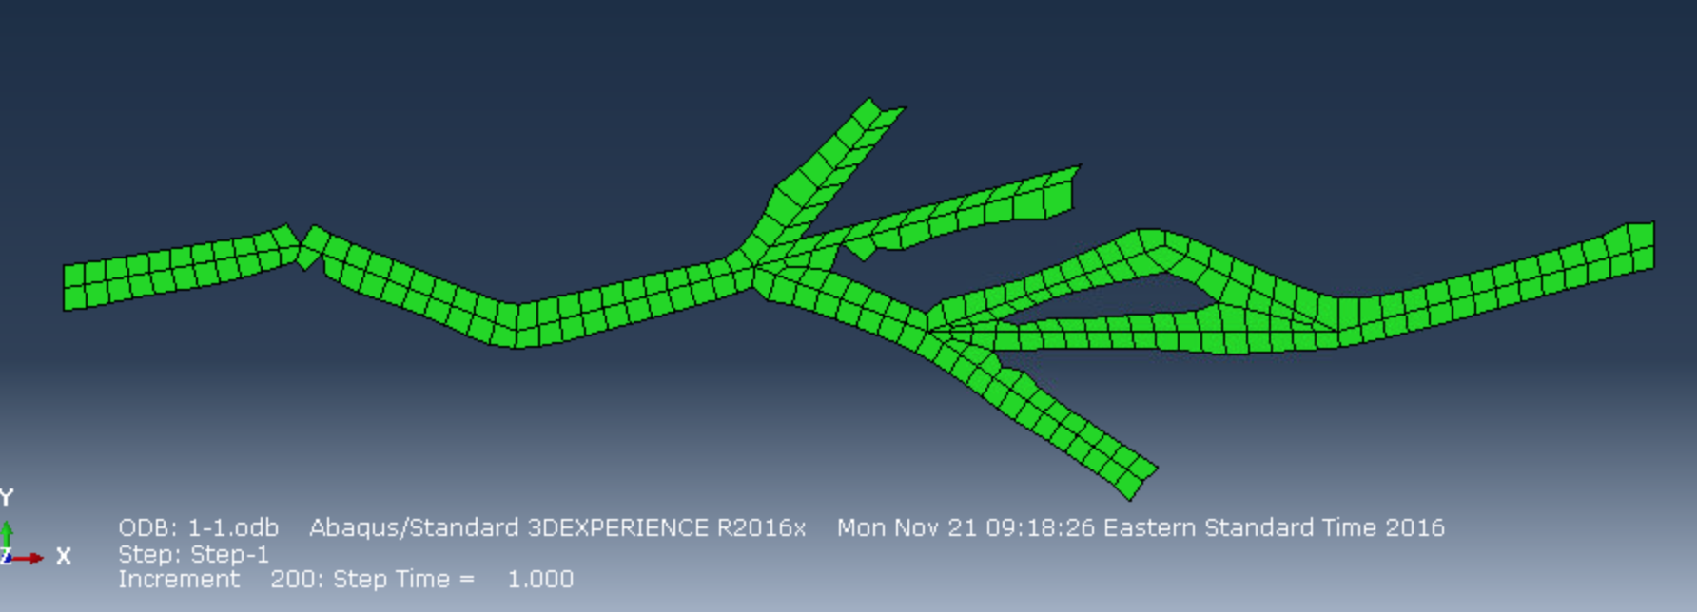
Current Success
1. Tree
2. Into several sub cracks
3. Join sub cracks back together

Slide 3
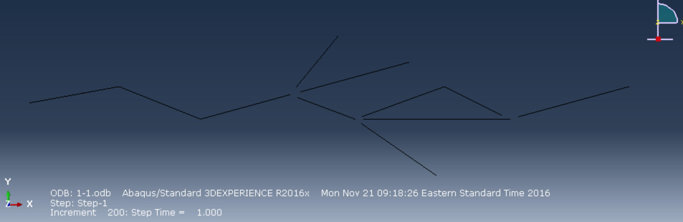

Slide 4
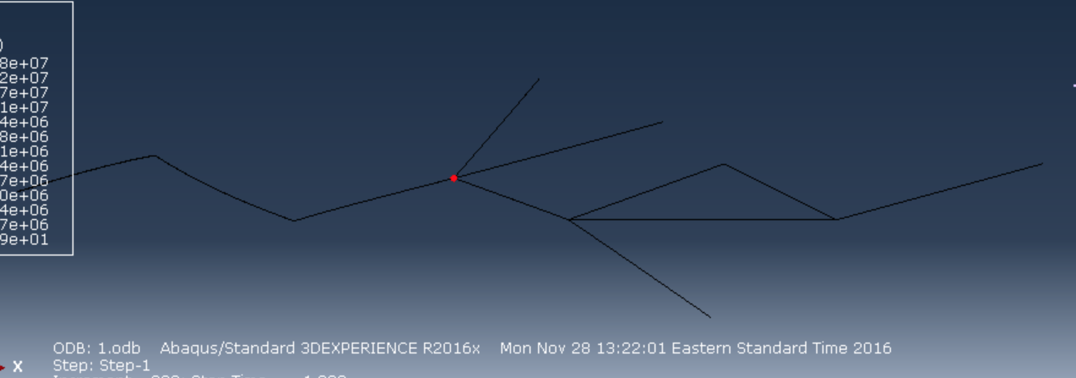

Slide 5
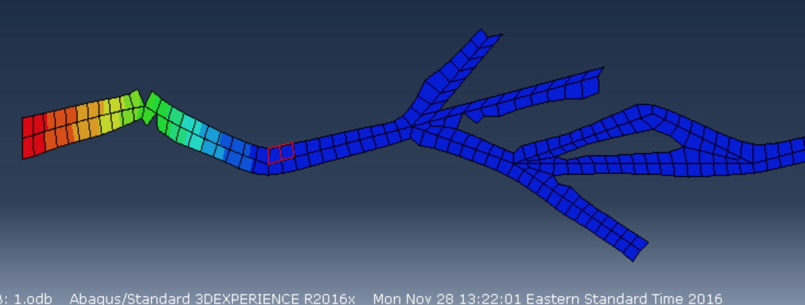

Slide 6
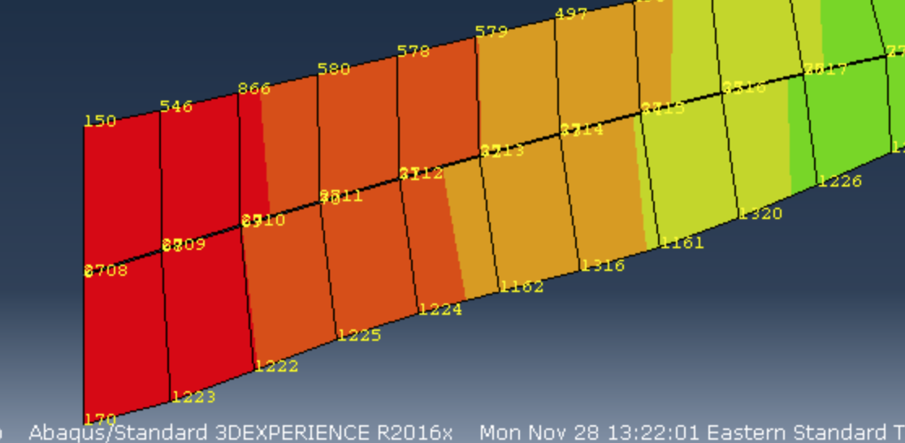
Correctness

Slide 7
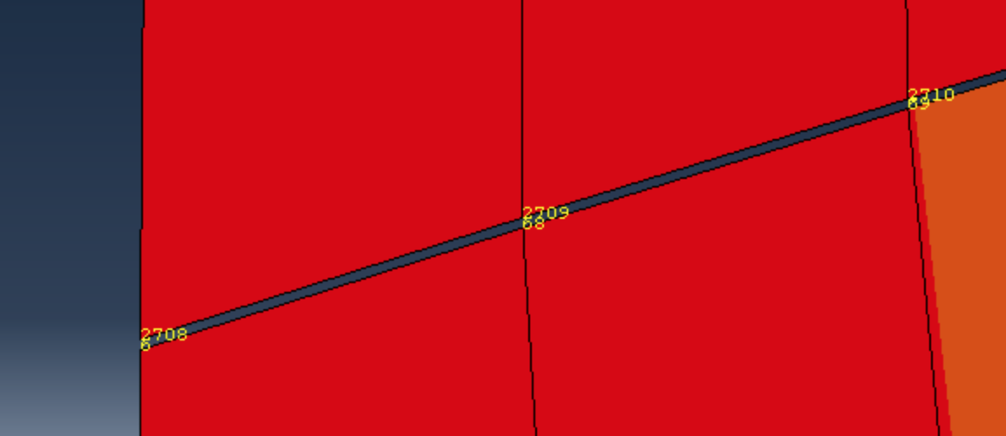

Slide 8
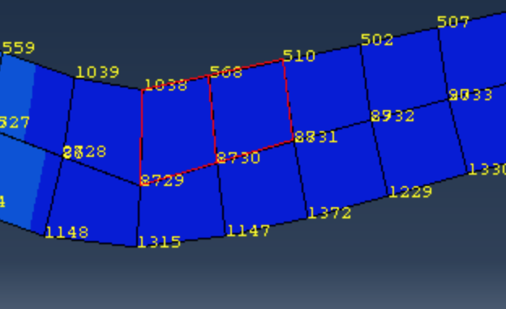

Slide 9
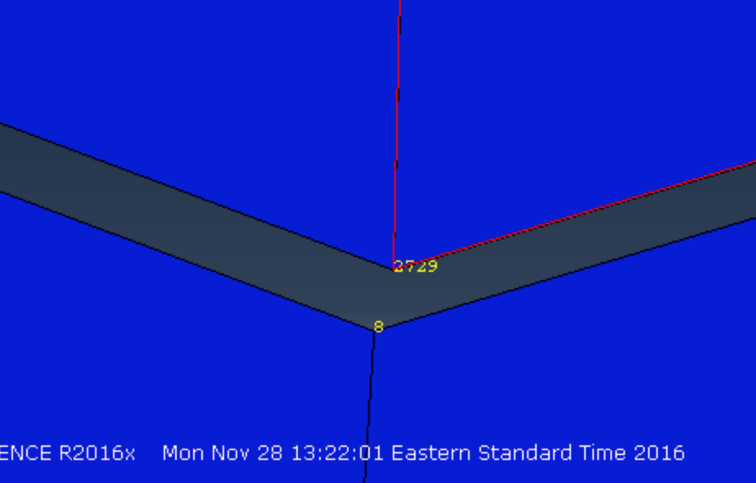

Slide 10
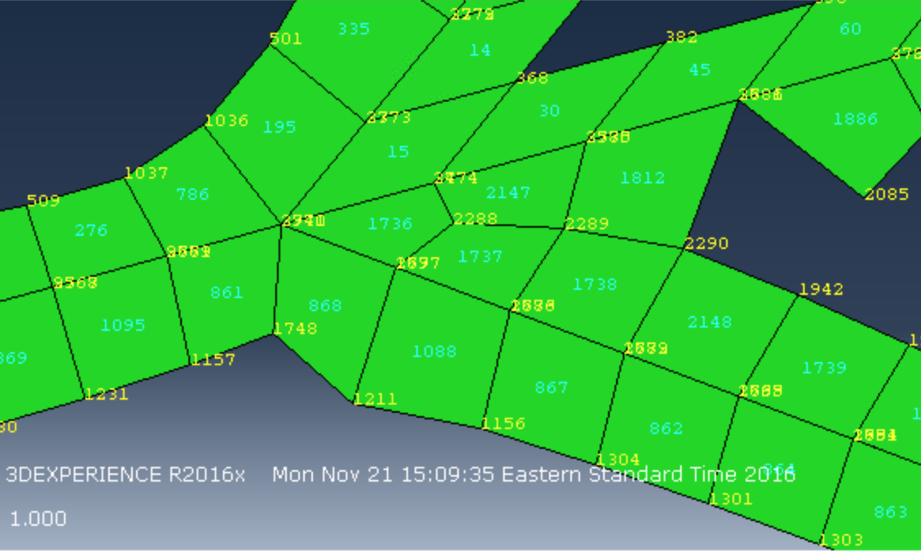
Difficulties
unchange
Easy until joining single cracks back together
1. Update element partially
3 types element
Unchanged Neighbor, change neighbor, middle
Each has 2 possible memberships, unchanged or change
2^3 = 8 cases
change

Slide 11
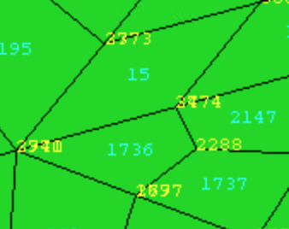
Things to considered when joining
8 * 2 = 16 cases

Slide 12
Start joining
unchange
change

Slide 13
Another 2 cases – neighbors or not neighbors
16 * 2 = 32 cases
unchange
change

Slide 14
Things needed to be fixed
Assuming 2 elements shared one node

Slide 15
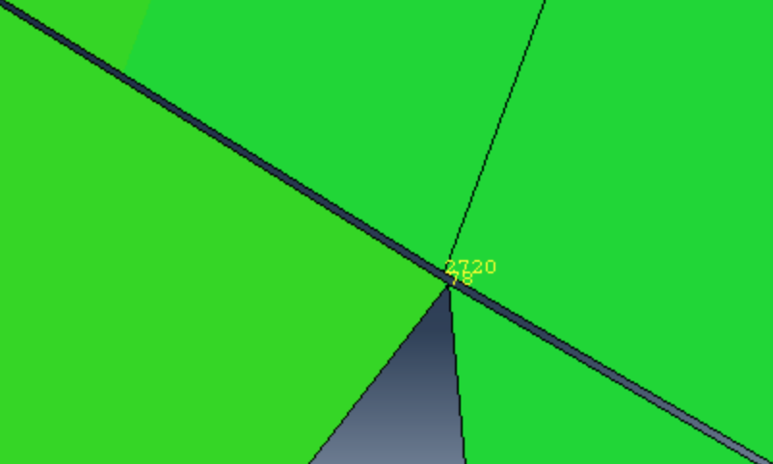

Slide 16
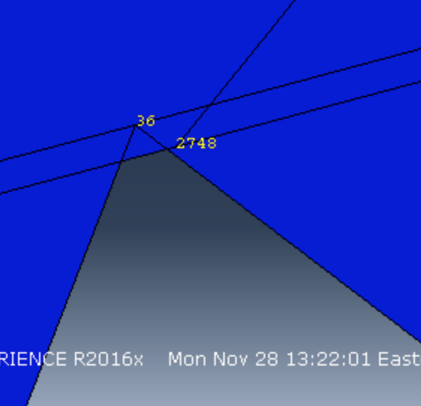

Slide 17
Rearrangement on codes
Move some lines into helper functions
Comments

Slide 18
Class github and wiki
https://github.gatech.edu/VIP-RDMEGS(Rock Damage Modeling and Energy Geostorage Simulation)
Send me your work and slides @ jzeng31@gatech.edu

